Slide 1

OPENDOG SENIOR DESIGN
BUILDING A BRIDGE BETWEEN DEPARTMENTS

Slide 2


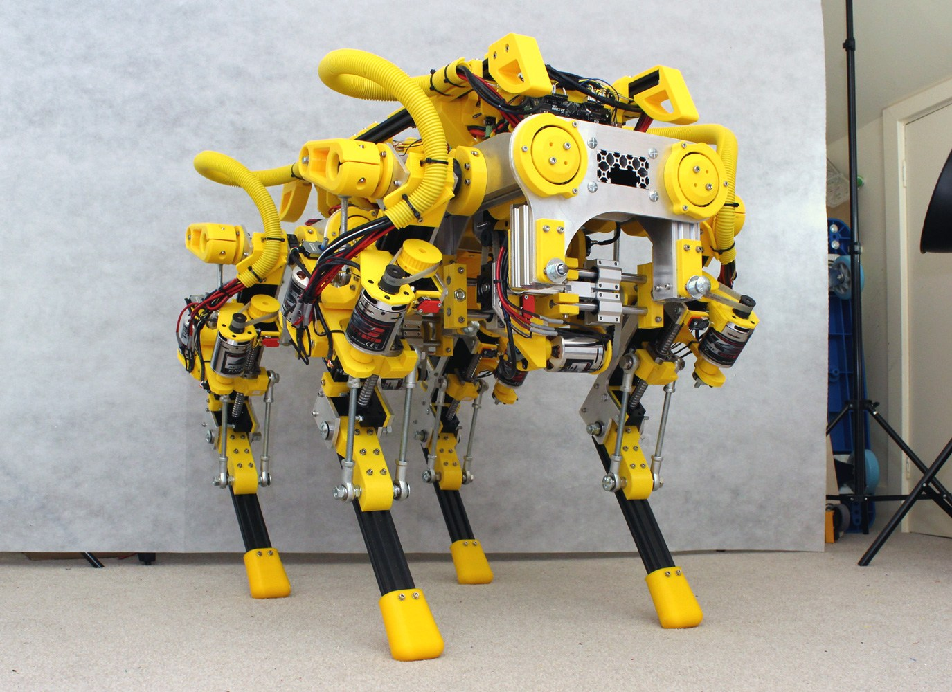
WHAT IS GOING ON
We are attempting to bring a cross department project to multiple graduating seniors
We want to facilitate open communication and have a more accurate experience for engineering work
Notes:
Create a multidisciplinary team to build an experiment platform…
The platform can be used for teaching and research…
The work is structured as a Senior Design/Capstone Project in ME 190/191

Slide 3
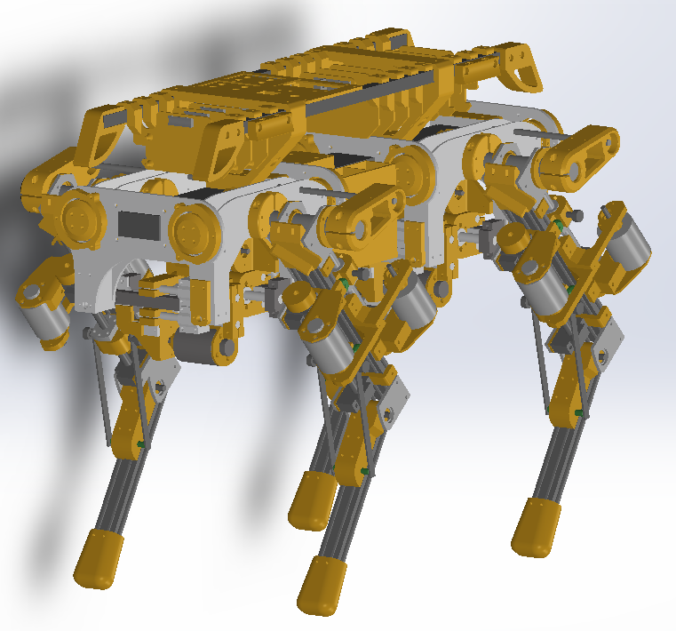
WORK DONE SO FAR
The initial design is open source.
We have a kinematic model
All of the source code is written in Arduino
The motor drivers are open source hardware
We have a CAD model that we remixed from the open source version
Notes:
The kinematic model we are going to have to disassemble from the Arduino code provided, We don’t necessarily want to run this thing with Arduino We are open to other drivers, we are still working on what the necessary engineering requirements are

Slide 4
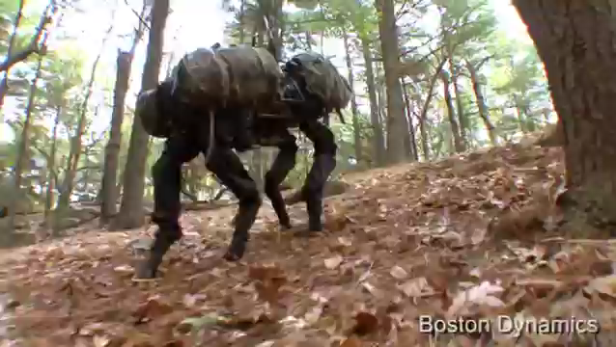

Slide 5
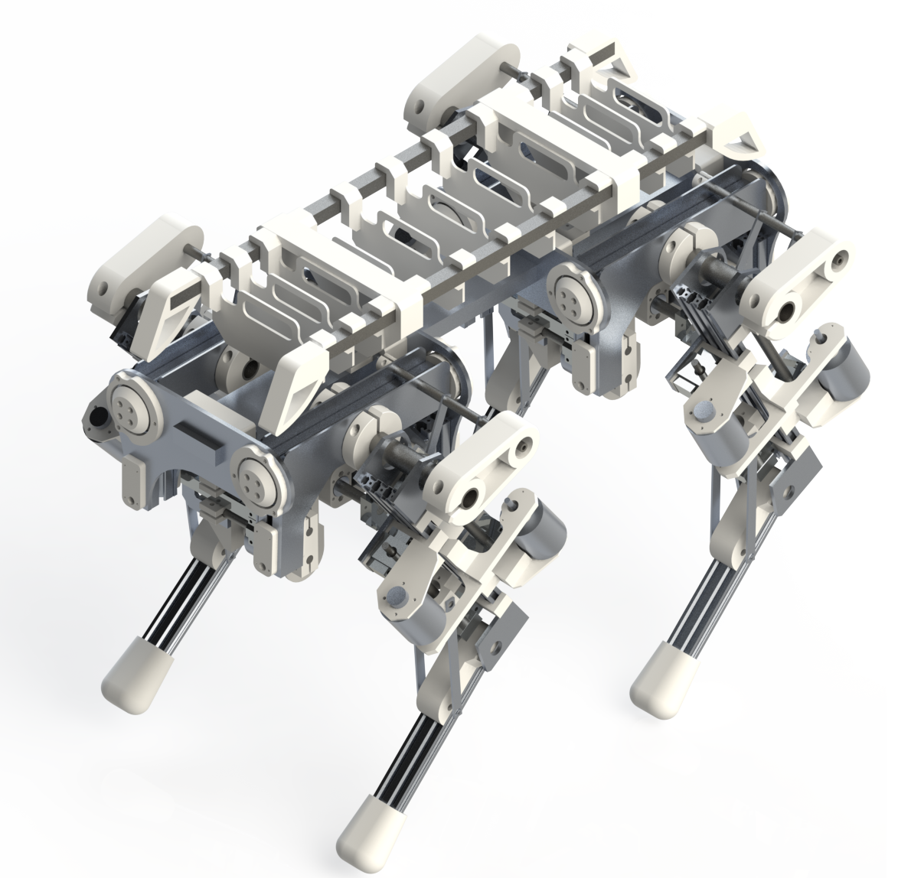
WORK TO DO
Teach/program the dog to walk at least 10m
Develop a kinematic model of the system for simulation/programming/training
Adaptation of the kinematic model in C and Python
Efficiencies and optimization of both hardware and software
Notes:
The 10m (32.8 ft) is a hard goal We want proper documentation for the code and the model (of which we are going to be making a matlab/Simulink model for We want to migrate away from Arduino so we can apply machine learning in the future to aid in better dynamic characteristics
There are a thousand things that can be improved, added on, or replaced

Slide 6
Proposed team composition and tasksWQscaczscsdfvafs
MECHANICAL
ELECTRICAL
COMPUTER SCIENCE
Kinematic and dynamic model for the walking of the Dog
Structural analysis
Dynamic system analysis
Battery management system
Sensor and motor integration with control hardware
Microcontroller system selection, programming, and debugging
Matlab model integration for dynamic response
Working UI
Control system programming
Notes:
Mechanical: Matlab/Simulink model for the walking dynamcs as well as a proper model and structural and fatigue test of components
Electrical: Integration of Power electronics, sensor processing, microcontroller integration, and actuator dynamics CS: getting the dynamic model to work with input and feedback, potentially machine learning, and backend work and support

